Slide 1

Confidential
(permanently)
Overseas Marketing Division FY2017 Business Strategy
June 1, 2017
Overseas Marketing Division
Junichiro Kitagawa

Slide 2
2
Enhancing
integrated management of
manufacturing-sales
(1) Enhancing precision of sales forecasts
(2) Establishing cycle for managing sales companies

Slide 3
(1) Enhancing precision of sales forecasts
3
Supporting the setup of infrastructure for further managerial integration of manufacturing-sales
Starting with “precision of sales forecast to enhance” and “sales forecasts to streamline”
Precision of
sales forecasts
to enhance
・ Completely fill in forecasts for the next six months
・ Responsibly put down most precise forecast up to N+3
【Sales Companies】
【Business Divisions】 Correctly return ATP
⇒Identifying issues preventing this cycle from working properly
Elimination of root causes, and develop necessary mechanisms
⇒Start communicating KPI report on forecasting precision from
2nd half of the fiscal year onward
What
should
be
Sales
forecasts to
streamline
【Actual Situation】 Multiple sales forecasts such as sales company DASH,
F Chart, and CMD figures co-exist in a mixed fashion.
⇒Overseas sales forecast is streamlined into ”S” of sales company PSI
Promote development of rules and mechanisms for streamlining into DASH
1st Half
2nd Half
FY18
Enhance precision
of sales forecasts
Discuss KPIs
Decide common KPIs / evaluation pillars
Communicate KPIs ～ Evaluate
Streamline
sales forecasts
Analyze issues
Develop rules / mechanism
Implement

Slide 4
(2) Establishing cycle for managing sales companies
4
Actual situation of business management capability at sales companies
Actual
situation
Latest 2-year results of headquarters’ audits against overseas sales companies
⇒Of 23 sales companies audited, five of which received C rating, and eight of
which received B- rating.
Notably, such areas as financial management, sales management, ISP
management frequently received low ratings.
Audit areas
Major issues
Financial
management
■Inventory plan is habitually unaccomplished for both monetary amount and
inventory days. A lack of improvement has had negative impact on net cash.
■Low recovery rate for Accounts Receivables
Sales
management
■Concentration of sales at month-end (The last three days of a month represent 75% of monthly
sales on average, with the last day representing 66%).
■The deviation ratio is ±5％ or greater from the sales forecasts made two months ago. Imprecise forecasts.
■More products without deficiency are returned year by year. While no root-cause analysis is performed,
no approval of President is obtained when they are returned.
ISP/Product
control
■Accumulated inventory continues representing a great amount and
high %.
■On-site audit is not performed. No write-off done for inventory of discontinued items.
To enable further evolution of AP company’s integrated management of manufacturing-sales,
it is urgent to consistently improve business management capability of sales companies.

Slide 5

(2) Establishing cycle for managing sales companies
5
Issues & action plans for strengthening business management capability of sales companies
Issues
■ Enormous burden on local business managers trying to meet requirements from
various angles (e.g. headquarters reporting and audit requests).
■ Limitation of resources handling manual workarounds, suffering from delays in IT
optimization of business management tasks.
“Project to enhance business management capability of Sales companies”
(1) Set up 10 minimum focus areas of business management where sales companies must work on. Each area is controlled transparently through use of a globally standardized format.
(2) Enable IT-driven shift from material preparation to control & improvement Further redesigned dashboard will enable all to view it in a timely manner
(3) Establish cycle for each Sales company to review its KPIs and discuss action plans
Business
management
areas
Sales progression management, (2) Gross profit management,
(3) Credit management, (4) Inventory management,
(5) Product returns management, (6) Control over PSI precision,
(7) P/L by products, (8) P/L by channels, (9) Management of expenses from
advertising and sales expansion, (10) Service-related KPIs
Roadmap
2016/2nd half | 2017/1Q | 2Q | 3Q | 4Q
AP’s explanation to each
country head of Finance on
objectives of standardization
and management areas
Selection of
project members
from each region
Development of
working schedules
Use of IT（according to schedules of each company / each control area)
・Areas of inadequacies to be managed
・Areas to control in developing current manual
・Migration to dashboard
Gap analysis of
actual vs.
standard
Review of operations
with use of IT
in mind

Slide 6
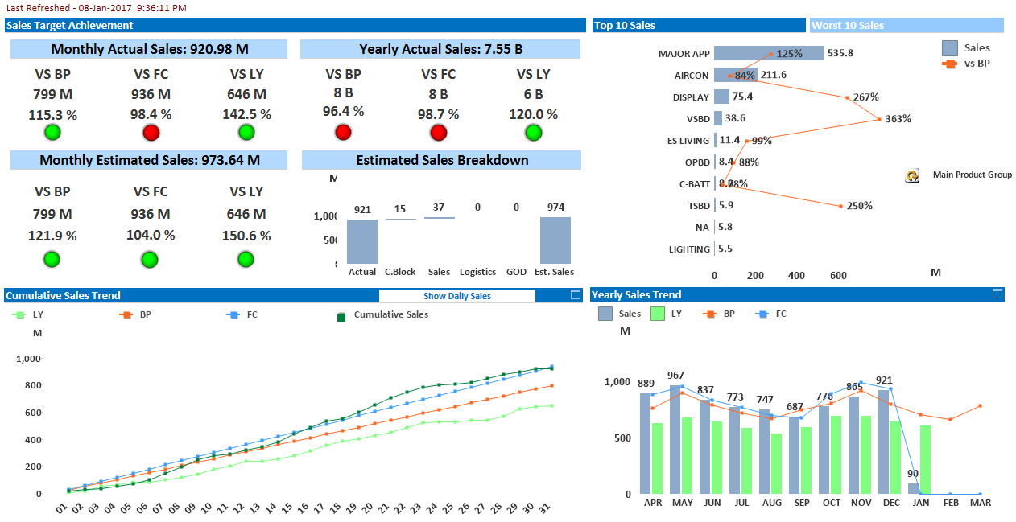
Asia Management Dashboard Update
6
Sales
Sales KPI
Sales Achievement
Sales Speed
Forecast Accuracy
Overall picture of BP/LY/Forecast ratios
Sales value/BP achievement level
by product categories
Daily sales progression
Monthly actual sales performance against Forecast

Slide 7
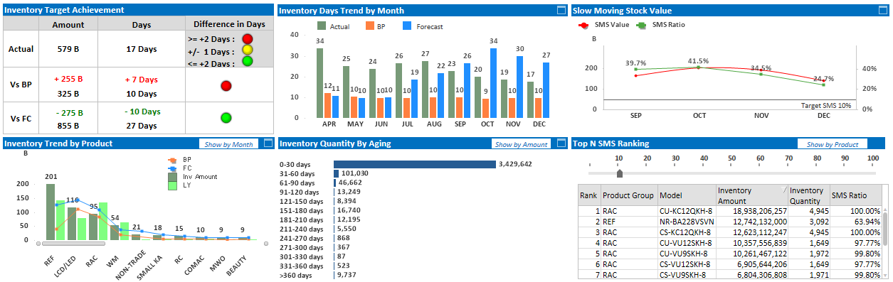
Asia Management Dashboard Update
7
Inventory
Inventory
KPI
Inventory Achievement
Inventory Days
Slow Moving Stock
BP/Forecast ratio for inventory
Monthly inventory gap from BP/forecast
Monthly trending of
slow-moving stock value
Inventory quantity
by aging periods
Possible to map out
all categories by models
Inventory value by products &
BP/LY/Forecast ratios

Slide 8
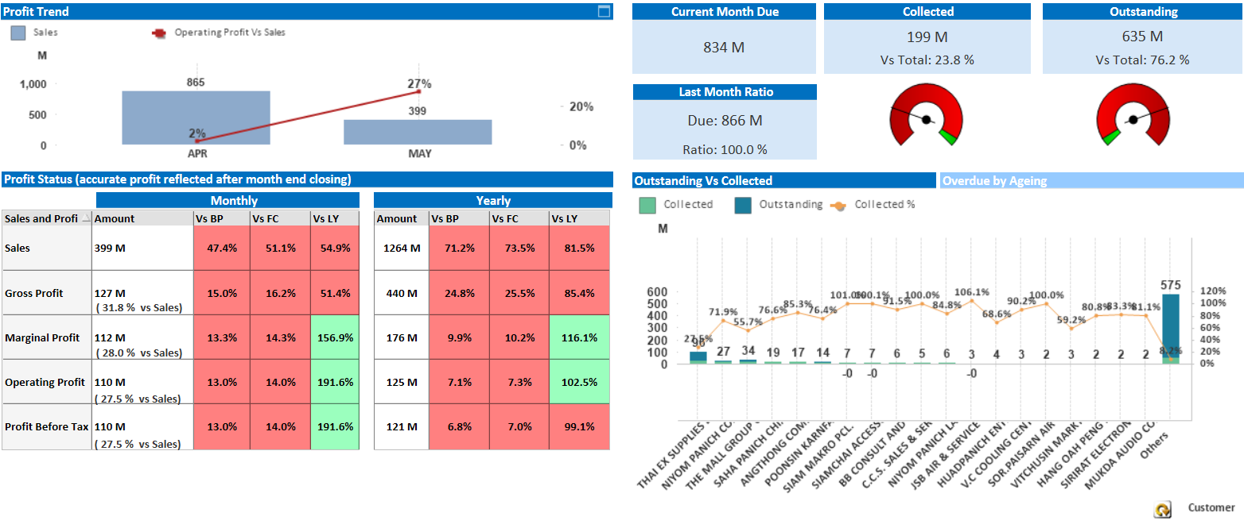
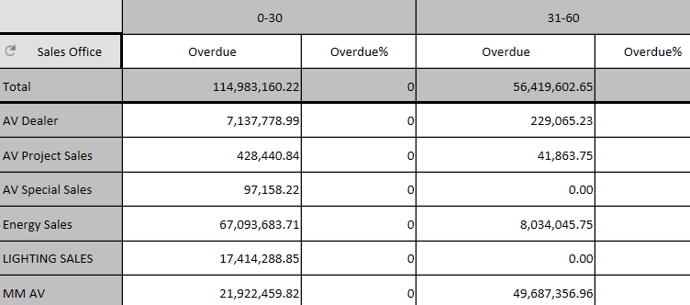
Asia Management Dashboard Update
8
Finance
Finance
KPI
Profit Achievement
AR overdue
AR collections
AR recovery status by major customers
P&L’s BP/LY/Forecast ratios
AR Overdue
Possible to map it out in
Overdue details by customers

